Slide 1
Hypothesis Testing Result
Version – 1.0
Created by Prashant Nair
Senior Data Scientist and PM

Slide 2
Creating a statistical model for predicting PROFIT
Use-case: 50_Startups.csv
Features: R&DSpend: Numerical Data
Administration: NUmerical Data
Marketing: Numerical Data
State: Categorical
Label:
Profit: Numerical Data

Slide 3
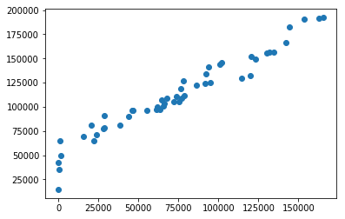
Type of Test: Pearson’s Correlation Coeff
Nature of Test: To identify whether features are linear or not
Null Hypothesis (H0) = R&D Spend and Profit has no linear relationship
Alternate Hypothesis (H1) = R&DSpend and Profit has linear relationship
Formula
Result:
Correlation: 0.9729004656594831
P-value: 3.5003222436906035e-32
Confidence Level : 100.0 %
Alternate Hypothesis (H1) - R&DSpend and Profit has linear relationship

